Slide 1
Interactive Data Exploration with Smart Drill-Down
Manas Joglekar
Hector Garcia-Molina
Aditya Parameswaran

Slide 2
---Points---
What problem? Why important(?)
Like poster, start with picture of file. Explain we want to get value out of it.
Rules, interestingness, flexible, interactive
Weight and Score
Formal problem
Soln sketch
Examples

Slide 3
Overview
Problem Setting and Motivation
Algorithm
System Architecture
Experiments

Slide 4
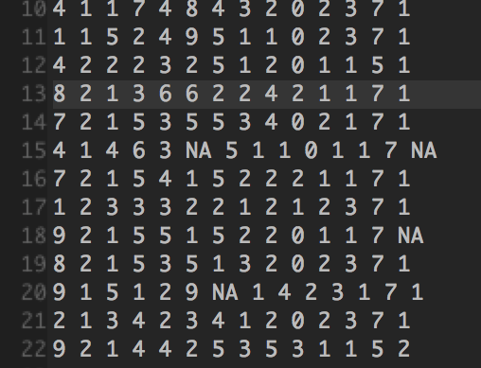
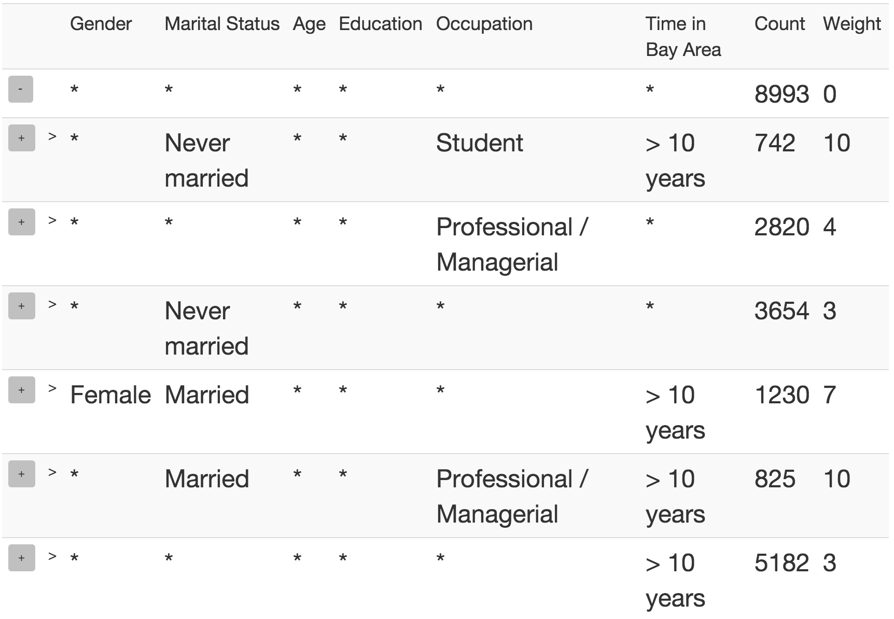
Summarizing a Table
Most interesting frequent `patterns’

Slide 5
OLAP Drill-Down
Explore relational Databases
Drill Down/ Roll Up
$10 Billion market
Limitations
Too many values
Single column

Slide 6
Smart Drill-Down
Present k most interesting patterns
Find interesting portions faster
Interactive
Instantiate multiple columns
User tunable
Complementary functionality!

Slide 7
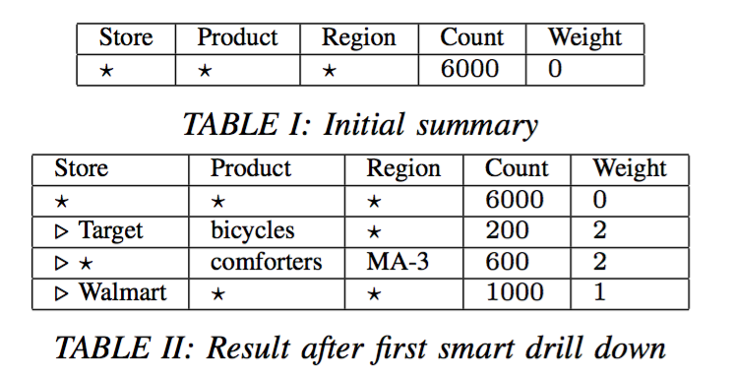
Example

Slide 8
Example

Slide 9
Definitions
Rule: Pattern of values and *’s
Count:
Subrule:
Weight: User-defined interestingess measure
Rule-List: Ordered list of rules
Score:

Slide 10
Formal Problem
Problem 1: Given a table T , a monotonic weighting function W, and a number k, find the list R of k rules that maximizes
for one of the following smart drill down operations: • [Rule drill down]
• [Star drill down]

Slide 11
Weight functions
Must be non-negative, monotone
Examples
Size
Bits

Slide 12
Overview
Problem Setting and Motivation
Algorithm
System Architecture
Experiments

Slide 13
High level Algorithm
Theorem: Let R, R’ be rule-lists with same set of rules, where rules in R are sorted by weight (decreasing). Then
Thus, always sort rules by weight!
Find best set rather than list.
Still NP-Hard

Slide 14
Submodularity
Define
where S is rule-set, R is weight-sorted rule-list
Then Score is submodular
Theorem: The greedy algorithm achieves a
approximation

Slide 15
High level Algorithm

Slide 16
Finding the best marginal rule
Brute-force: Compute marginal value for all rules?
Too expensive
A Priori-like algorithm
If R₂ is sub-rule of R₁,
Max Weight Parameter m_{w}.

Slide 17
Overview
Problem Setting and Motivation
Algorithm
System Architecture
Experiments

Slide 18
Scaling to large datasets
Sampling
Predict clicks and maintain samples
NP-Hard
DP approximation

Slide 19
System Architecture

Slide 20
Overview
Problem Setting and Motivation
Algorithm
System Architecture
Experiments

Slide 21
Experiments
Datasets
Marketing Survey
Census
Studies
Qualitative
Quantitative

Slide 22
Size weighting

Slide 23
Bits weighting

Slide 24
Running time vs. mw

Slide 25
Running time vs. minSS

Slide 26
Count error vs. minSS

Slide 27
Rule error vs. minSS

Slide 28
Thank You!!
Questions?

Slide 29
 | Chapter 2,3 | Chapter 4
Motivating Application | Crowdsourcing | Knowledge Base Construction
Ground Truth | Flexible | Limited
Regularity | - | -
Overlap | High | Flexible
Scale | Few | Flexible
Features | - | Required
Domain Knowledge | - | Flexible

